Slide 1
Mass Storage Structure Lesson 3 Storage Management
David Liu
Fall 2021, Spring 2022

Slide 2
Error Detection and Correction
Fundamental aspect of many parts of computing (memory, networking, storage)
Error detection determines if there a problem has occurred (for example a bit flipping)
If detected, can halt the operation
Detection frequently done via parity bit
Parity one form of checksum – uses modular arithmetic to compute, store, compare values of fixed-length words
Another error-detection method common in networking is cyclic redundancy check (CRC) which uses hash function to detect multiple-bit errors
Error-correction code (ECC) not only detects, but can correct some errors
Soft errors correctable, hard errors detected but not corrected

Slide 3
Storage Device Management
Low-level formatting, or physical formatting — Dividing a disk into sectors that the disk controller can read and write
Each sector can hold header information, plus data, plus error correction code (ECC)
Usually 512 bytes of data but can be selectable

Slide 4
Storage Device Management
To use a disk to hold files, the operating system still needs to record its own data structures on the disk
Partition the disk into one or more groups of cylinders, each treated as a logical disk
Volume creation and management: a logical drive, a single accessible storage area with a single file system
Logical formatting or “making a file system”
To increase efficiency most file systems group blocks into clusters
Disk I/O done in blocks
File I/O done in clusters
Raw disk
access for apps that want to do their own block management,
keep OS out of the way (databases for example)

Slide 5
Storage Device Management (cont.)
Root partition contains the OS, other partitions can hold other OSes, other file systems, or be raw
Mounted at boot time
Other partitions can mount automatically or manually
Boot loader stored in NVM, mortherboard
Bootstrap program, boot blocks, secondary storage
load the kernel from the file system
Or a boot management program for multi-os booting

Slide 6
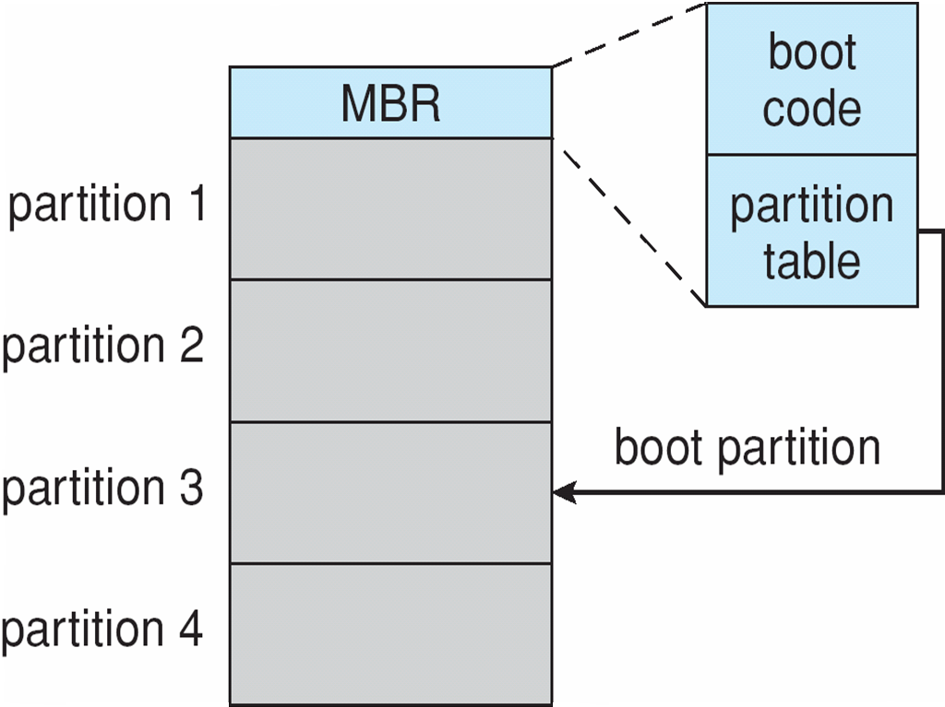
Device Storage Management (Cont.)
Boot block initializes system
The bootstrap is stored in ROM, firmware
Bootstrap loader program stored in boot blocks of boot partition
Methods such as sector sparing used to handle bad blocks
Booting from secondary storage in Windows

Slide 7
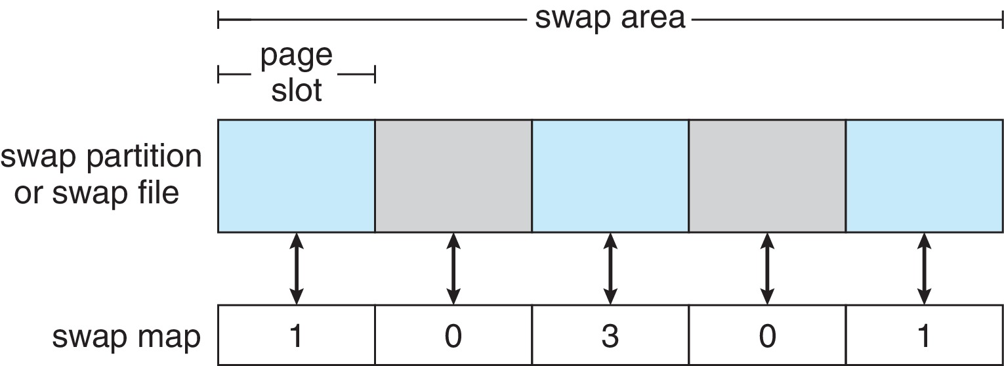
Swap-Space Management
Used for moving entire processes (swapping), or pages (paging), from DRAM to secondary storage when DRAM not large enough for all processes
Operating system provides swap space management
Secondary storage slower than DRAM, so important to optimize performance
Usually multiple swap spaces possible – decreasing I/O load on any given device
Best to have dedicated devices
Can be in raw partition or a file within a file system (for convenience of adding)
Data structures for swapping on Linux systems:

Slide 8
Swap-Space Management
Linux uses swap-space only for anonymous memory
Data structures for swapping on Linux systems:

Slide 9
Storage Attachment
Computers access storage in three ways
host-attached
network-attached
cloud

Slide 10
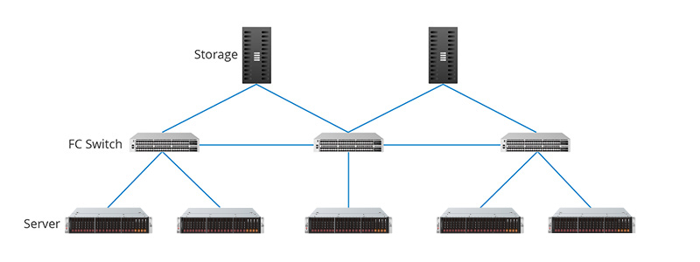
Host Attached Storage
Host attached access through local I/O ports, using one of several technologies
Storage busses such as
USB,
firewire,
thunderbolt
High-end systems use fibre channel (FC)
High-speed serial architecture using fibre or copper cables
Multiple hosts and storage devices can connect to the FC fabric

Slide 11
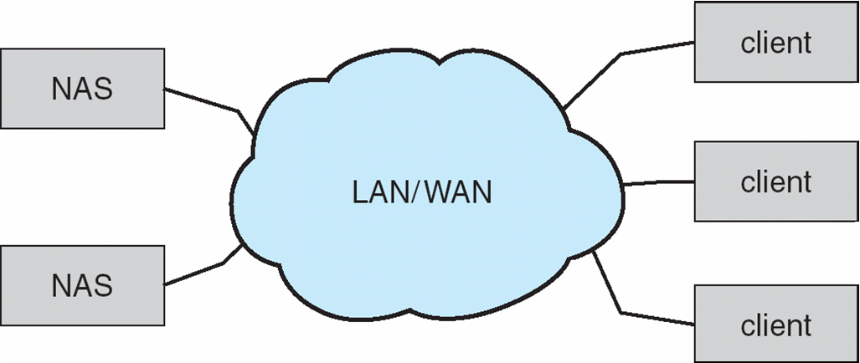
Network-Attached Storage
Network-attached storage (NAS) is storage made available over a network rather than over a local connection (such as a bus)
Remotely attaching to file systems
NFS and CIFS are common protocols
Implemented via remote procedure calls (RPCs) between host and storage over typically TCP or UDP on IP network
iSCSI protocol uses IP network to carry the SCSI protocol
Remotely attaching to devices (blocks)

Slide 12
Cloud Storage
Similar to NAS, provides access to storage across a network
Unlike NAS, accessed over the Internet or a WAN to remote data center
NAS presented as just another file system, while cloud storage is API based, with programs using the APIs to provide access
Examples include Dropbox, Amazon S3, Microsoft OneDrive, Apple iCloud
Use APIs because of latency and failure scenarios (NAS protocols wouldn’t work well)

Slide 13
Storage Area Network
Common in large storage environments
Use Storage Protocol for communication
Multiple hosts attached to multiple storage arrays – flexible

Slide 14
Storage Area Network (Cont.)
SAN is one or more storage arrays
Connected to one or more Fibre Channel switches or InfiniBand (IB) network
Hosts also attach to the switches
Storage made available via LUN Masking from specific arrays to specific servers
Easy to add or remove storage, add new host and allocate it storage
Why have separate storage networks and communications networks?
Consider iSCSI, FCOE

Slide 15
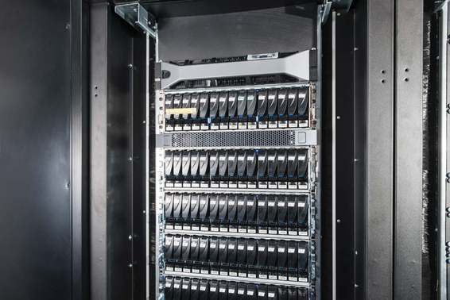
Storage Array
Can just attach disks, or arrays of disks
Avoids the NAS drawback of using network bandwidth
Storage Array has controller(s), provides features to attached host(s)
Ports to connect hosts to array
Memory, controlling software (sometimes NVRAM, etc)
A few to thousands of disks
RAID, hot spares, hot swap (discussed later)
Shared storage -> more efficiency
Features found in some file systems
Snaphots, clones, thin provisioning, replication, deduplication, etc
A Storage Array

